Slide 1
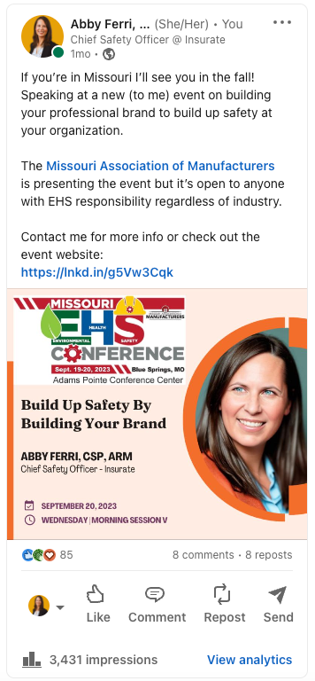

MISSOURI EHS CONFERENCE
Building Up Safety by Building Your Brand
Presented by Abby Ferri, CSP, ARM
Chief Safety Officer

Slide 2
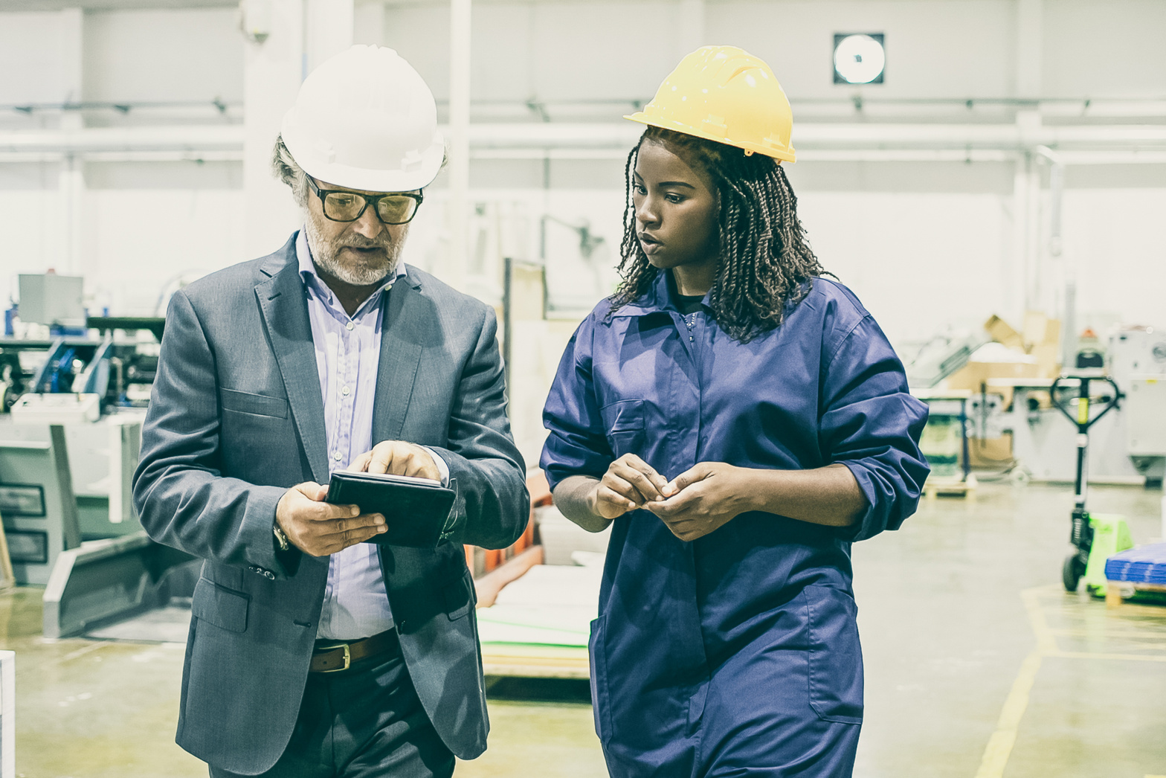
Key takeaways:
  Identify what people know you for and if that is accurate
  Strategies for short consistent relationship building conversations
  Describe the importance of psychological safety

Slide 3



What is your professional brand?
  When people see you, what do they think or feel about you?
  What do people ask you about all the time?
  What adjectives do people use to describe you to someone you don't know?
  What adjectives do people use to introduce you to new people?

Slide 4

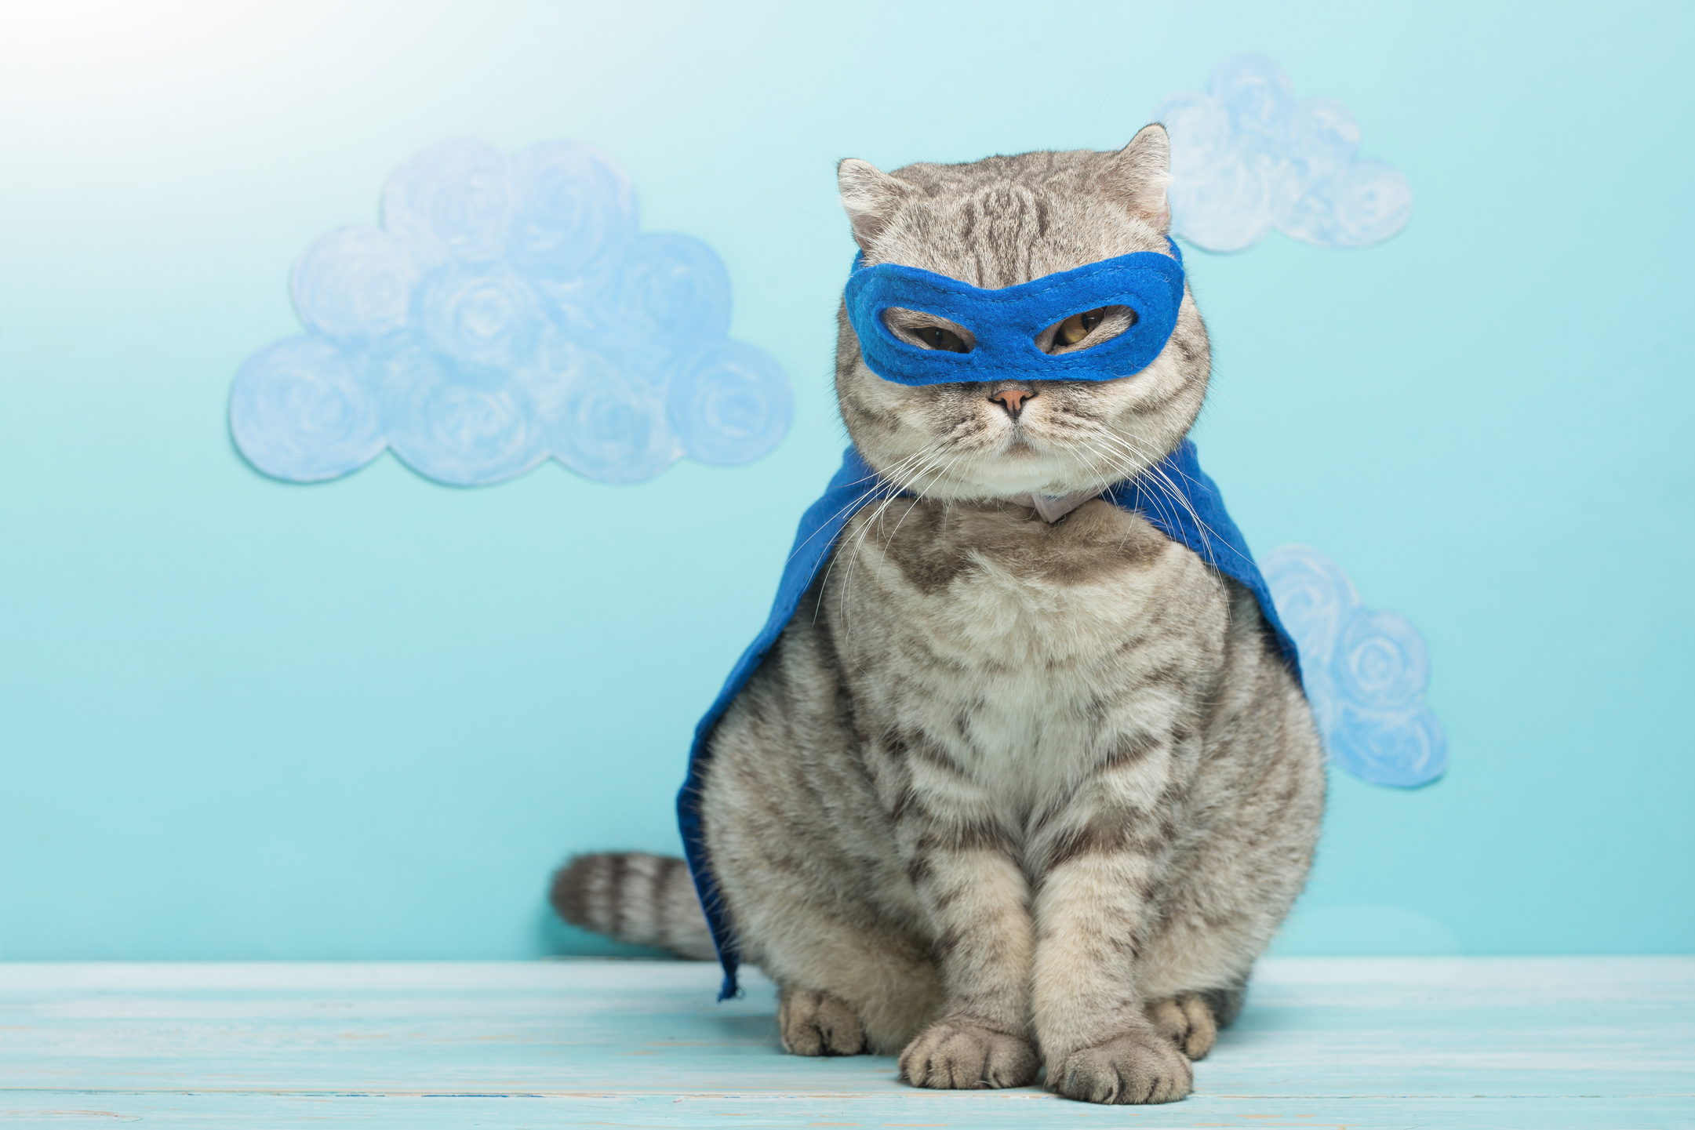

Self Awareness is a Superpower
Your brand guides your communication
It provides a lens for evaluation and a framework for conversation. You can be you. It's easier to communicate with others that way!
Your brand is there when you aren't
We need to call ____. You should call _____.
What does ____ need to approve this?
You can evolve your brand
As your goals and descriptors change because you're growing in your career, your brand will evolve too.

Slide 5
It's OK to not know
Steps to build (or boost) your professional brand
What are your goals in the next year?
What do you want to be known for?
Use the adjectives others use
Try out a brand
Make it a thing

Slide 6
What are your goals this year?
  Personal
  Organizational
  Professional

Slide 7
What do you want to be known for?
  How do you want to be perceived?
  Start with a longer list and pare down.

Slide 8
  I'm "practical and creative" - what have you been called?
  Combine the descriptors:
    smart & approachable
    hard working & trustworthy
Use the adjectives others use.

Slide 9
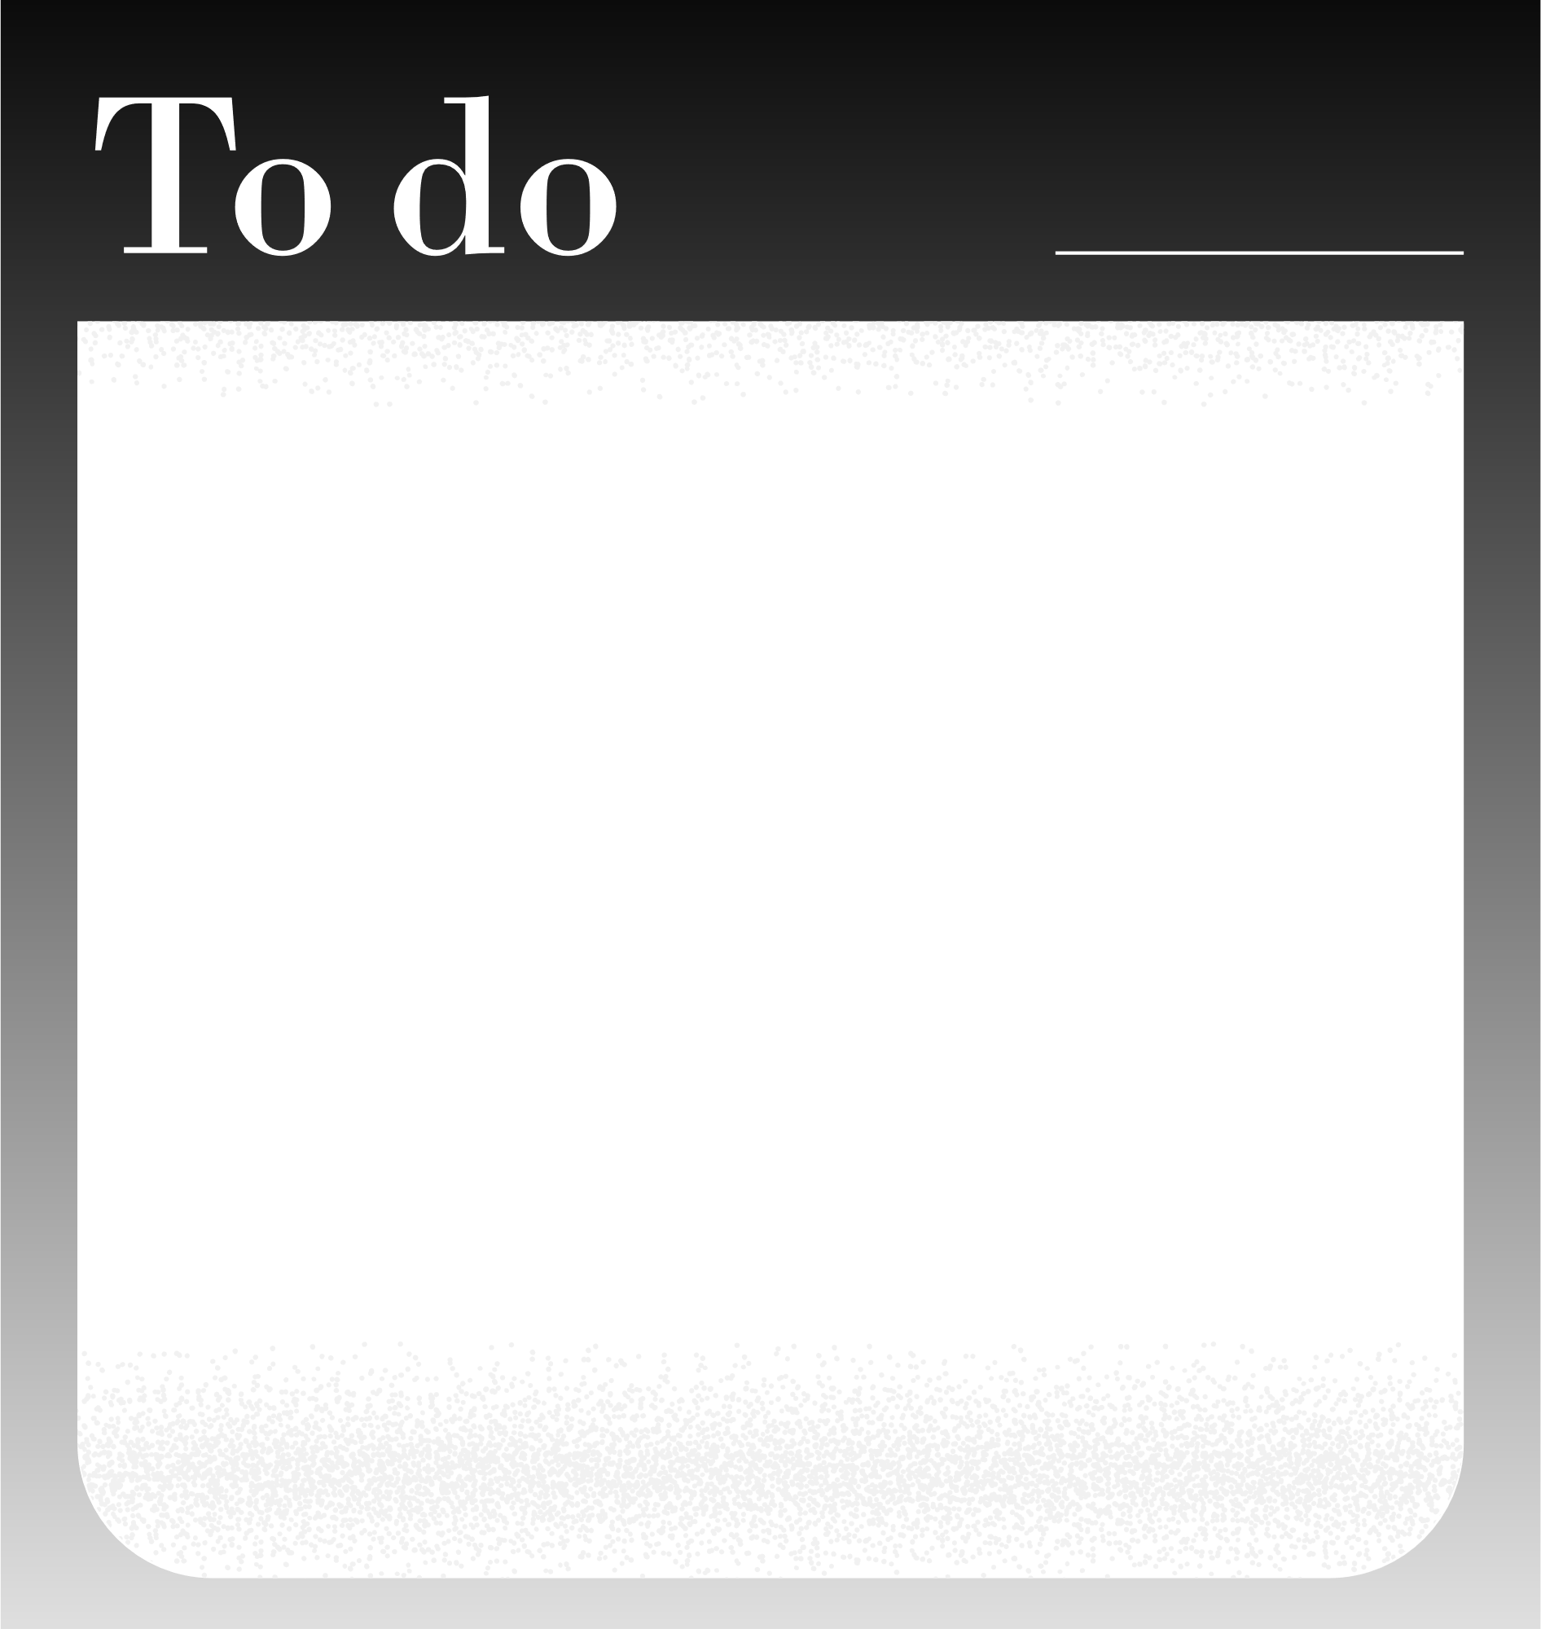
  Using this exercise and what you knew before today, try on a brand and see what happens.
Try out a brand

Slide 10
  Use your brand with others in conversations.
  Atomic Habits question: would a person that ____ do ____?
Make it a thing.

Slide 11






Let's take this show on the road!
Become a source of useful information, develop better sources.
  Identify open-ended conversation starters.
  Keep conversations Personal, Useful, and Brief (shockingly brief)
Establish trust & credibility through short consistent relationship building communication informed by your brand.
Some ideas
  Surprise people by communicating practical, useful and timely info they can immediately put to use. (adult learning principles 101)
  ABC: always be conscious of how you can improve on this approach.

Slide 12

Aim to be consistently relevant. Discussions become relationship-building, credibility-boosting, genuine, and sometimes surprising.
Abby Ferri

Slide 13
“Psychological safety is a belief that one will not be punished or humiliated for speaking up with ideas, questions, concerns, or mistakes.”
Dr. Amy C. Edmondson, author of The Fearless Organization

Slide 14
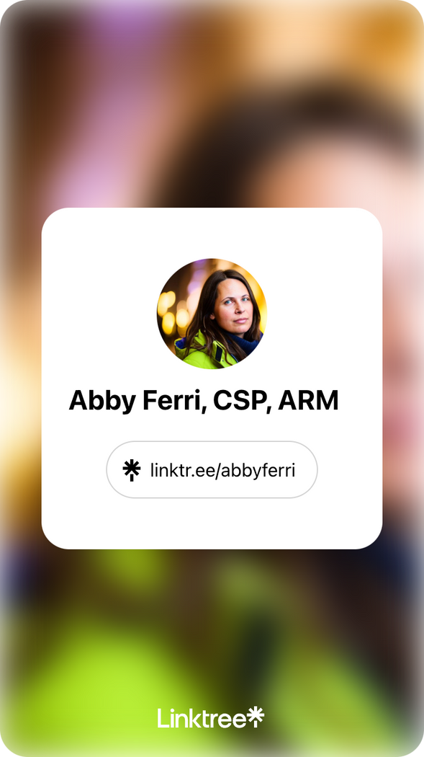
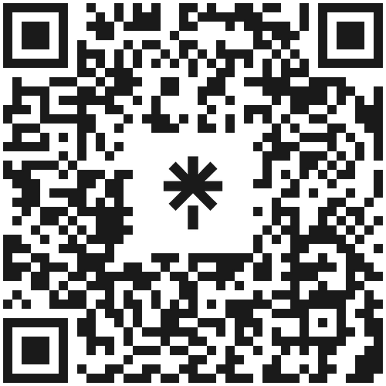

Stay connected
I'm now invested in your success!
Email Address
aferri@insurate.com
Website
www.insurate.com
www.theusisa.com

